Slide 1
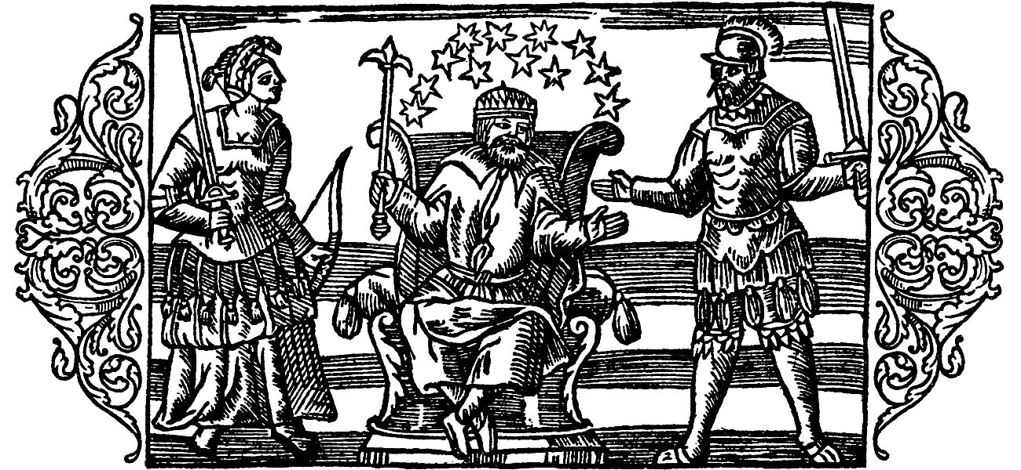

Imagining Nordic Paganism
Scandinavian Pre-Christian religion has been an eminently productive part of identity constructions for numerous social groups from the 13th century until the present day. This conference brings together researchers from several countries and various disciplines in order to investigate why, by which means and to what ends diverse recipients at different times engaged in identitarian recourse to a religion that is accessible only from spatially or temporally external perspectives in the extant source material. In doing so, the conference encompasses a diachronic dimension, asking how subsequent processes of reception interrelate and how later acts of reception engage with notions of paganism established earlier in the history of reception. Furthermore, it aims at a synchronic layer, placing specific reception processes in the socio-political contexts and preconditions of their time. The contributions address a wide array of topics connected to the reception of pre-Christian religion in the North and beyond, such as the relation between gender and paganism, its connectivity to certain media, the spatial dimension of its reception, and, not least, identitarian recourses to paganism in historiography and the history of the discipline. Thus, turning to some particularly salient aspects of the reception history of paganism from the Middle Ages until recent times, the contributions aim at facilitating a better understanding of its special viability for identity constructions attested to by countless examples from eight centuries of imagining Nordic paganism.
Cluster of Excellence ‘Religion and Politics’
The Cluster of Excellence has been investigating the complex relationship between religion and politics across eras and cultures since 2007. The 140 researchers from 20 disciplines in the humanities and social sciences are focusing in the current funding phase (2019 to 2025) on the ‘dynamics of tradition and innovation’. In transepochal studies ranging from antiquity to the present day, they are analyzing the conditions and factors that make religion an engine of political and social change, with their focus being above all on the paradox that religions often develop their innovative potential precisely by drawing on their traditions. The research network is the largest of its kind in Germany; and, of the Clusters of Excellence, one of the oldest and the only one to deal with the issue of religion. It will receive funding of 31 million euros from 2019 to 2025.
Organization
Cluster of Excellence ‘Religion and Politics’ Prof. Dr. Roland Ludger Scheel and Simon Hauke, M.A. Phone: +49 251 83-32820 rscheel@uni-muenster.de Project A3-36 of the Cluster of Excellence: “Paganisations: Memorialised Paganism as an Element of Scandinavian and European Identities” religionundpolitik@uni-muenster.de @religionundpolitik www.religion-und-politik.de/en
Location and registration
Cluster of Excellence lecture theatre Room JO 101 (1st floor) Johannisstraße 4, 48143 Münster We kindly ask for your registration until 24 October 2025 (skandinavistik@uni-muenster.de).
International Conference of the Cluster of Excellence “Religion and Politics” and the Institute for Scandinavian Studies
Imagining Nordic Paganism
Cultural Memories and Scholarly Thought since the Middle Ages 6-7 November 2025
Image: Olaus Magnus – On the three Main Gods of the Geats. https://de.m.wikipedia.org/wiki/Datei:Olaus_Magnus_-_On_the_three_Main_Gods_of_the_Geats.jpg

Slide 2
Programme
Thursday, 6 November 2025
08:30
Registration
09:00–09:30
Welcome and Introduction
Roland Scheel and Simon Hauke, Münster
09:30–10:15
The Blind One in the Forest: Viability as a Guiding Principle in Constructions of the Pagan North
Simon Hauke, Münster
Media and Pagan-Christian Dichotomies
10:15–11:00
Who’s Afraid of the Fuþorc? The Challenge the Old English Runes Pose to Present-Day Conceptions of Nordic Paganism
Kerstin Majewski, Bochum
11:00–11.30
Coffee
11:30–12:15
Runes and Paganism: An ad hoc Created Binomial
Alessia Bauer, Paris
12:15–13:00
The Eddas as Neopagan Bible? A Diachronic Approach to a
Pagan-Christian Equation
Lukas Rösli, Berlin
13:00–14:30
Lunch
14:30–15:15
Shifting Attitudes to Pre-Christian Myth: The Case of Þórr’s
Journey to Geirrøðr
Tom Grant, Utrecht
15:15–16:00
Gods in the Heliand: Paganization of a Carolingian Time Christian Text
Heike Sahm, Göttingen
16:00–16:30
Coffee
Space, Social Groups, and the Nation
16:30–17:15
Paganitas, Urbanitas, and the People of Trøndelag in Saga Perception
Benjamin Allport, Oslo
17:15–18:00
Icelandic Constructions of Nordic Paganism
Gylfi Gunnlaugsson, Reykjavík
18:00–18:15
Coffee
18:15–19:00
Cyrus the Great and the Diaspora: On Iranian Nationalism Today and its References to Ancient Iran
Philip Bockholt, Münster
Friday, 7 November 2025
Gender and Emotion
09:00–09:45
Female Conceptions of Paganism and Conceptions of the Female in Paganism
Katja Schulz, Frankfurt am Main
09:45–10:30
Paganism as Female Agency in Fredrika Bremer and Selma
Lagerlöf
Anna Bohlin, Bergen
10:30–11:00
Coffee
11:00–11:45
Eg likar ikkje snakket ditt (I don’t like your talk): Old Norse Mythological Sources and Jon Fosse’s Edda (2017)
Jóhanna Katrín Friðriksdóttir, Oslo
Historiography, Law, and Scholarship
11:45–12:30
Outsider Perspectives on Old Scandinavian Beliefs in Brot um fornan átrúnað
Jonas Wellendorf, Berkeley
12:30–13:30
Lunch
13:30–14:15
Harrowing Past: Old Norse Laws’ Attitude to the Scandinavian Heathen Period
Jiří Starý, Praha
14:15–15:00
Pagan Law? Imagining Pre-Christian Origins and Contents of Legal Norms in Medieval Scandinavia
Roland Scheel, Münster
15:00–15:30
Coffee
15:30–16:15
Conceptions of (Continental) Germanic Paganism from Jordanes to Felix Dahn (and beyond)
Christian Scholl, Münster
16:15–17:00
Jan de Vries, Otto Höfler, and their Networks for Distributing Conceptions of a Germanic Past in the 20th Century
Bob van Strijen, Oslo
17:00–17:15
Coffee
17:15–18:00
Concluding Discussion

